Slide 1
BM7703
Cross cultural issues in international business
Week 2
Theories of culture and how culture influences our behaviour
Sara hooke

Slide 2
This week we are going to look at…
how culture influences our behaviour, and how this can help or hinder building business relationships and connections in multicultural and global contexts.

Slide 3
Why are we looking at this?
It links to our learning outcomes
…demonstrate an understanding in the specialised fields of intercultural issues and cross-cultural issues in an international management context
… demonstrate an understanding of existing theoretical and methodological approaches in the field of cross-cultural studies relating to international business management to support critical analysis and evaluation of current theory.
select, critically evaluate and apply knowledge from a wide range of advanced theories, techniques and information sources, both creatively and flexibly to synthesise ideas and create solutions for unfamiliar cross-cultural situations in international and multicultural contexts.

Slide 4
Why are we looking at this?
It links to your assessment…
https://moodle.glos.ac.uk/mod/assign/view.php?id=1978799
This session will help you to develop an understanding of the theories used to understand the dimensions of culture that you will need to underpin your arguments in your assessment.

Slide 5
Plan of the session
Teaching on cultural dimensions
Combined Break and individual reading activity
  HBR article Navigating the Cultural Minefield- Erin Meyer
Seminar exercise discussing in groups country cultures for assessment

Slide 6
Cultural dimensions
Today we are going to explore
Hofstede
Schwartz
Trompenaars
Meyer

Slide 7
What is culture?
Varner and Beamer (2005), “the coherent, learned, shared view of a group of people about life’s concerns that ranks what is important, furnishes attitudes about what things are appropriate, and dictates behavior” (p. 5)
Hofstede (1980)
“collective programming of the mind’
…dictates how we behave, how we act and how we react.
Notes:
The lens through which we view the world based on our own societal norms, our values and traditions
The invisible backpack
‘Ranks what’s important’- set different priorities
This all depends on the culture we have grown up in- what we have learnt from parents, grandparents, teachers etc
And that dictates how we behave, how we act and how we react.
Bikini beach example

Slide 8
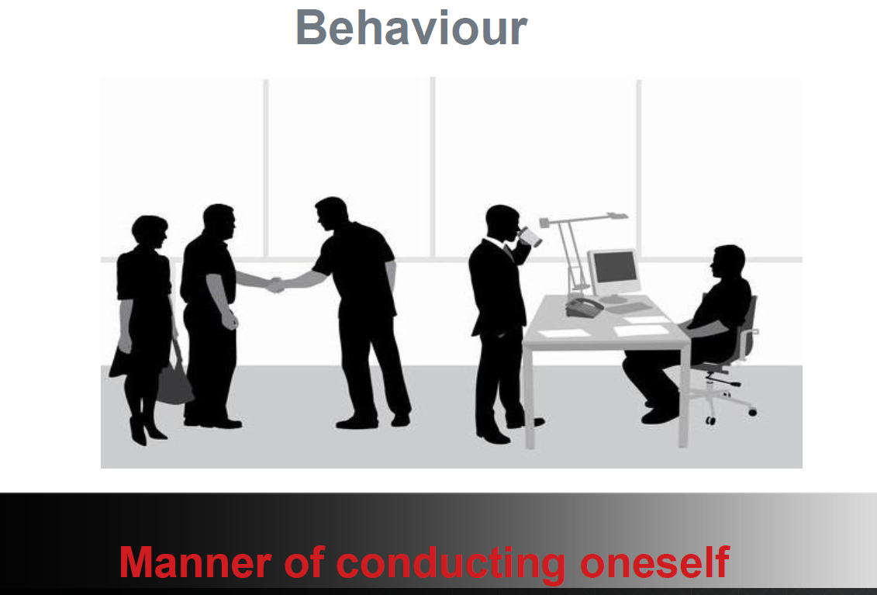
Notes:
Culture = Behaviour= manner of conducting oneself
Look at these pictures
What is the difference?
Formal/ informal
Client meeting
In the office- who is the boss?
This is what we are going to learn about today

Slide 9

Greetings from around the world

Slide 10

Greetings from around the world

Slide 11
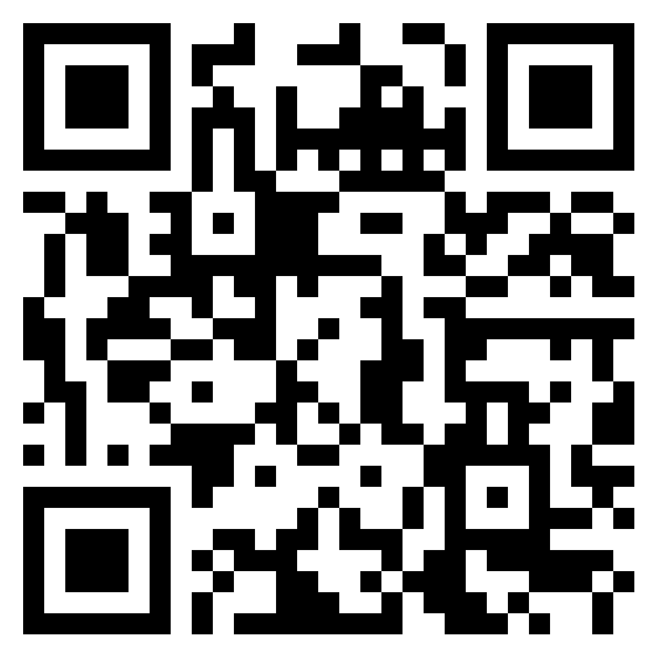
What do we do when we meet people for the first time?
https://uniofglos.padlet.org/shooke/bm7703-greetings-in-different-cultures-week-2-ibzhts4qyv8ddpkc

Slide 12
Cultural differences are there Even from our first interaction
Notes:
Cultural differences are visible Even from our first interaction. Our behaviour when we first meeting someone can have a great impact on our relationship with them going forward.

Slide 13
Hofstede Cultural dimensions
Geert Hofstede, worked for IBM in the 1960’s and 70’s
Published ‘Cultural constraints in Management Theories’ in 1993
The model can provide a useful framework for understanding how cultural differences can affect business dealings
Started with 4 dimensions- now has six
https://www.hofstede-insights.com/country-comparison-tool
Notes:
Hofstede's cultural dimensions theory is a framework for cross-cultural psychology, developed by Geert Hofstede. It shows the effects of a society's culture on the values of its members, and how these values relate to behavior.
Geert Hofstede, worked for IBM in the 1960’s and 70’s, he compared the answers of 117,000 IBM matched employee samples on the same attitude survey in different countries.
Hofstede based his research on national cultural preferences rather than individual cultural preferences
Putting together national scores (from 1 for the lowest to 100 for the highest), Hofstede's six-dimensions model allows international comparison between cultures

Slide 14
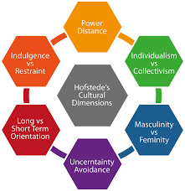
Hofstede’s cultural dimensions
Notes:
Masculinity vs Feminity has had a name change Motivation towards Achievement and Success

Slide 15
Power distance
The degree to which the less powerful members of a society accept and expect that power is distributed unequally.
A higher degree of the Index indicates that hierarchy is clearly established and executed in society, without doubt or reason
Opposite of a hierarchical society= Egalitarian
Notes:
China 80, Nigeria 80, High
Austria 11 low and scandanavian countries
UK and Germany 35
Japan 54
In the workplace- how easy it to speak to the boss- beyond a line manager. Are you on first name terms?

Slide 16
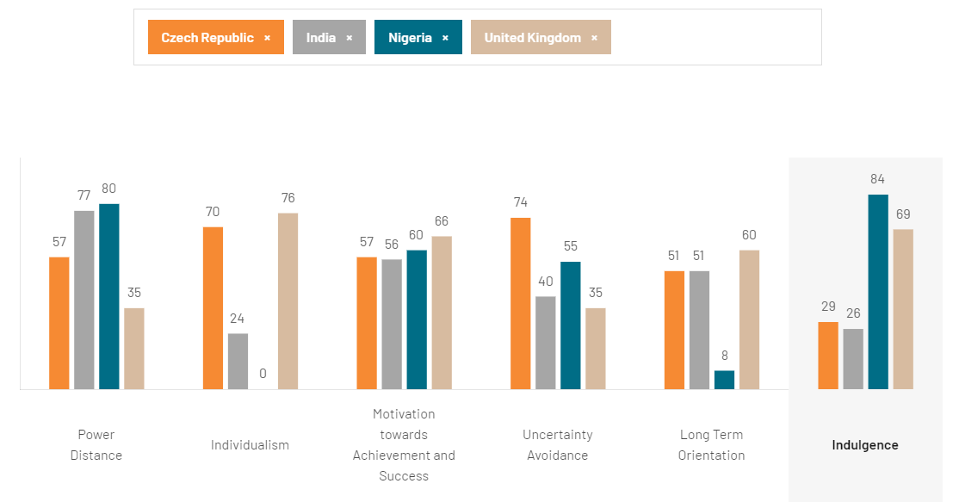

Slide 17
INDIVIDUALISM (IDV) vs collectivism
The high side of this dimension, called Individualism, can be defined as a preference for a loosely-knit social framework in which individuals are expected to take care of only themselves and their immediate families.
Individualist: US, Canada, UK
Collectivist: Hong Kong, Singapore and Mexico
Nigeria highly collectivist.
Notes:
Individualistic societies have loose ties that often only relate an individual to his/her immediate family. They emphasize the "I" versus the "we". Its counterpart, collectivism, describes a society in which tightly integrated relationships tie extended families and others into in-groups. These in-groups are laced with undoubted loyalty and support each other when a conflict arises with another in-group
Indian society is collectivistic and promotes social cohesion and interdependence. The traditional Indian joint family, which follows the same principles of collectivism, has proved itself to be an excellent resource for the care
Nigeria- Close long-term commitment to the member ‘group’, be that a family, extended family, or extended relationships. Loyalty in a collectivist culture is paramount and overrides most other societal rules and regulations. The society fosters strong relationships where everyone takes responsibility for fellow members of their group.
How easy is it to get a job in a highly collectivist culture?
In groups take care of each other in return for loyalty.

Slide 18
MASCULINITY VS FEMININITY (MAS)
Now known as Motivation towards achievement and success.
The Masculinity side of this dimension represents a preference in society for achievement, heroism, assertiveness, and material rewards for success. Society at large is more competitive.
Femininity, stands for a preference for cooperation, modesty, caring for the weak and quality of life. Society at large is more consensus-oriented.
Masculinity: Japan, Austria, Italy
Feminity: Sweden, Norway, the Netherlands
Notes:
Masculinity vs Femininity has had a name change Motivation towards Achievement and Success
A high score (Decisive) on this dimension indicates that the society will be driven by competition, achievement and success, with success being defined by the winner / best in field - a value system that starts in school and continues throughout organisational life. A low score (Consensus-oriented) on the dimension means that the dominant values in society are caring for others and quality of life. A Consensus-oriented society is one where quality of life is the sign of success and standing out from the crowd is not admirable. The fundamental issue here is what motivates people, wanting to be the best (Decisive) or liking what you do (Consensus-oriented). (From the Culture Factor website)

Slide 19
UNCERTAINTY AVOIDANCE (UAI)
The degree to which the members of a society feel uncomfortable with uncertainty and ambiguity. The fundamental issue here is how a society deals with the fact that the future can never be known: should we try to control the future or just let it happen?
Low: Singapore, Jamaica, Denmark
High: Greece, Portugal, Japan
Notes:
"a society's tolerance for ambiguity",
Societies that score a high degree in this index opt for stiff codes of behavior, guidelines, laws, and generally rely on absolute truth, or the belief that one lone truth dictates everything and that people know what it is. A lower degree in this index shows more acceptance of differing thoughts or ideas. Society tends to impose fewer regulations, ambiguity is more accustomed to, and the environment is more free-flowing

Slide 20
LONG TERM ORIENTATION (LTO)
Initially called Confucian dynamism.
Cultures which score high take a more pragmatic approach: they encourage thrift and efforts in modern education as a way to prepare for the future.
Societies that score low on this dimension (normative societies), prefer to maintain time-honoured traditions and norms while viewing societal change with suspicion.
Societies prioritise the two existential goals of maintaining some links with its own past while dealing with the challenges of the present and the future differently.
Long term: China, Japan
Short term: US, Canada
Notes:
A poor country that is short-term oriented usually has little to no economic development, while long-term oriented countries continue to develop to a level of prosperity
Japan 100- most long term oriented society In corporate Japan, you see long-term orientation in the constantly high rate of investment in R&D even in economically difficult times, higher own capital rate, priority to steady growth of market share rather than to a quarterly profit,
Nigeria 8 very low. They exhibit great respect for traditions, a relatively small propensity to save for the future, and a focus on achieving quick results.
https://www.hofstede-insights.com/country-comparison-tool?countries=india%2Cjapan%2Cnigeria%2Cunited+kingdom
UK 60 Britain a pragmatic culture. In societies with a pragmatic orientation, people believe that truth depends very much on situation, context, and time. They show an ability to adapt traditions easily to changed conditions, and a strong propensity to save and invest. thriftiness and perseverance in achieving results.
India has an intermediate score of 51 in this dimension, a dominant preference in Indian culture cannot be determined.
Societies that have a high score on pragmatism typically forgive a lack of punctuality, a changing game plan based on changing reality,

Slide 21
INDULGENCE (IVR)
Indulgence versus restraint
Indulgence stands for a society that allows relatively free gratification of basic and natural human drives related to enjoying life and having fun. Restraint stands for a society that suppresses gratification of needs and regulates it by means of strict social norms.
Indulgence scores are highest in Latin America, parts of Africa, the Anglo world and Nordic Europe.
Restraint is mostly found in East Asia and Eastern Europe.
Notes:
With a very high score of 84, Nigerian culture is said to be one of Indulgence. People in societies classified by a high score in Indulgence generally exhibit a willingness to realise their impulses and desires with regard to enjoying life and having fun. They possess
India receives a low score of 26 in this dimension, meaning that it is a culture of Restraint. Societies with a low score in this dimension have a tendency to cynicism and pessimism. Also, in contrast to Indulgent societies, Restrained societies do not put much emphasis on leisure time and control the gratification of their desires. People with this orientation have the perception that their actions are Restrained by social norms and feel that indulging themselves is somewhat wrong.a positive attitude and have a tendency towards optimism. In addition, they place a higher degree of importance on leisure time, act as they please and spend money as they wish.
A high score of 69 indicates that the British culture is one that is classified as Indulgent. People in societies classified by a high score in Indulgence generally exhibit a willingness to realise their impulses and desires with regard to enjoying life and having fun. They possess a positive attitude and have a tendency towards optimism. In addition, they place a higher degree of importance on leisure time, act as they please and spend money as they wish.

Slide 22
Schwartz’s national Culture Model
Created an alternative approach to Hofstede
Three pairs:
Embeddedness vs. Autonomy
Mastery vs. Harmony
Hierarchy vs. Egalitarianism
Schwartz, S.H. (1992). Universals in the content and structure of values : Theoretical advances and empirical tests in 20 countries. San Diego: Academic Press
Schwartz, S. H. (1994). Beyond individualism/collectivism: New cultural dimensions of values. In U. Kim, H. C.
Triandis, C. Kagitcibasi, S. C. Choi, & G. Yoon (Eds.), Individualism and collectivism: Theory, methods, and
applications (pp. 85–119). Thousand Oaks: Sage Publications.
Schwartz, S. H. (1999). A theory of cultural values and some implications for work. Applied Psychology: An
International Review, 48(1), 12–47.
Notes:
Created an alternative approach to Hofstede
A few years after Hofstede, Schwartz proposes new dimensions to characterize intercultural differences [Schwartz, S. H. (1992). Universals in the content and structure of values: Theoretical advances and empirical tests in 20 countries. Advances in Experimental Social Psychology, 25, 1–65.
His research overcomes several limitations of Hofstede’s early work: his focus on IBM employees only, the non-exhaustiveness of the first four dimensions, the limited number of countries (neither China nor Soviet countries was in in the Hofstede’s initial study) and several methodological weaknesses [McSweeney, B. (2002). Hofstede’s model of national cultural differences and their consequences: A triumph of faith — A failure of analysis. Human Relations, 55, 89–118. https://doi.org/10.1177/0018726702551004
Shalom Schwartz, an Israeli sociologist, identifies seven cultural values in three pairs, usually arranged in a circle.
Schwartz, S.H. (1992). Universals in the content and structure of values : Theoretical advances and empirical tests in 20 countries. San Diego: Academic Press Initially identified 56 individual values recognized across cultures, thus covering all value dimensions explaining inter-country cultural variation. He then examined which of these values had an equivalent meaning across countries, which reduced the number of useful values to 45.
And then after further analysis was able to narrow it down to 7 pairs
A few years after Hofstede, Schwartz proposes new dimensions to characterize intercultural differences [Schwartz, S. H. (1992). Universals in the content and structure of values: Theoretical advances and empirical tests in 20 countries. Advances in Experimental Social Psychology, 25, 1–65.

Slide 23
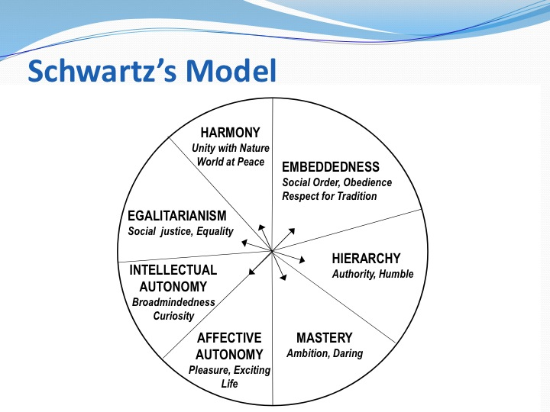

Slide 24
Notes:
Conservatism (also called embeddedness) represents a culture’s emphasis on maintaining the status quo, propriety, and restraining actions or desires that may disrupt the solidarity of the group or the traditional order
Intellectual and affective autonomy refer to the extent to which people are free to independently pursue their own ideas and intellectual directions, and their affective desires, respectively
Embeddedness
This is a focus on sustaining the social order, of avoiding change and retaining tradition. Group norms are important.
What does this remind you of? Hofstede Individualism/collectivism, LTO and Uncertainty Avoidance
Autonomy
Where individuals have control over their choices as opposed to having to consider others and shared rules.
Affective Autonomy is the independent pursuit of pleasure, seeking enjoyment by any means without censure. In many societies there are limits when affective autonomy leads to taking banned substances or acting in ways that distresses or harms others.
Intellectual Autonomy is the independent pursuit of ideas and thought, whether it is theoretical, political or whatever. In embeddedness cultures it is hard to police what people are thinking, though actions can be taken to monitor intellectual publishing and discussions.
What does this remind you of from Hofstede? Individualism

Slide 25
Notes:
Mastery
In a mastery culture, individuals seek success through personal action. Mastery needs independence, courage, ambition, drive and competence.
What does this remind you of?- Masc/Fem Hofstede (Motivation towards achievement and success)
Harmony
Rather than seek self-improvement, people are happy to accept their place in the world. People here put greater emphasis on the group than on the individual.
What does this remind you of?- Power distance in Hofstede
Mastery expresses the importance of getting ahead by being self assertive, while harmony denotes the importance of fitting harmoniously into the environment (Schwartz, 1999).

Slide 26
Notes:
Similar to power distance
Hierarchy
There is a clear social order, with some people in superior positions while others are in inferior positions. People here accept their position in the hierarchy and are expected to be modest and have due self-control.
Egalitarianism
Everyone is considered to be equal and everyone is expected to show concern for everyone else.
Hierarchy denotes the extent to which it is legitimate to distribute power, roles and resources unequally, while egalitarian commitment refers to the extent to which people are inclined to voluntarily put aside selfish interests to promote the welfare of others.
UK 35 Britain sits in the lower rankings of PDI – i.e. a society that believes that inequalities amongst people should be minimized. Interestingly is that research shows PD index lower amongst the higher class in Britain than amongst the working classes. The PDI score at first seems incongruent with the well established and historical British class system and its exposes one of the inherent tensions in the British culture – between the importance of birth rank on the one hand and a deep seated belief that where you are born should not limit how far you can travel in life. A sense of fair play drives a belief that people should be treated in some way as equals.
Nigeria 80 Nigeria scores high on this dimension (score of 80) which means that people accept a hierarchical order in which everybody has a place and which needs no further justification. Hierarchy in an organization is seen as reflecting inherent inequalities, centralization is popular, subordinates expect to be told what to do and the ideal boss is a benevolent autocrat
India 77 indicating an appreciation for hierarchy and a top-down structure in society and organizations. If one were to encapsulate the Indian attitude, one could use the following words and phrases : dependent on the boss or the power holder for direction, acceptance of un-equal rights between the power-privileged and those who are lesser down in the pecking order, immediate superiors accessible but one layer above less so, paternalistic leader, management directs, gives reason / meaning to ones work life and rewards in exchange for loyalty from employees. attitude towards managers are formal even if one is on first name basis. Communication is top down and directive in its style and often feedback which is negative is never offered up the ladder.
Japan 54 borderline hierarchical society. Yes, Japanese are always conscious of their hierarchical position in any social setting and act accordingly. However, it is not as hierarchical as most of the other Asian cultures. Some foreigners experience Japan as extremely hierarchical because of their business experience of painstakingly slow decision making process: all the decisions must be confirmed by each hierarchical layer and finally by the top management

Slide 27
Are you expected to be independent and look after yourself?
Are you expected to be interdependent?

Slide 28
Interactions- people and the group
Group is central
Hofstede- Collectivism
Interdependent, motivated by norms and duty, prioritise in group goals, connected relationships
Schwarz- Embeddedness
Search for meaning in social relationships, identification, shared way of life and shared goals
Individual is central
Hofstede- Individualism
Autonomous, independent, motivated by own needs and goals, rational relationships
Schwartz- Autonomy
Express own preferences, feelings, ideas and abilities
Notes:
Nigeria 0 Nigeria, with a score of 0, the lowest score in the database, is a highly collectivistic society. This is manifest in a close long-term commitment to the member ‘group’, be that a family, extended family, or extended relationships. employer/employee relationships are perceived in moral terms (like a family link), hiring and promotion decisions take account of the employee’s in-group,
Japan 62 Individualistic. Japanese society does not have an extended family system like China and Korea. Japan has been a paternalistic society and the family name and asset was inherited from the father to the eldest son. The younger siblings had to leave home and make their living with their core families. Japanese are famous for their loyalty to their companies, which people have chosen for themselves, which is an Individualist thing to do. You could say that the Japanese in-group is situational. Japanese are more private and reserved than most other Asians.
India 24 is a society with both collectivistic and Individualist traits. he employer/employee relationship is one of the expectations based on expectations – Loyalty by the employee and almost familial protection by the Employer. Hiring and promotion decisions are often made based on relationships which are the key to everything in a Collectivist society.The collectivist side means that there is a high preference for belonging to a larger social framework in which individuals are expected to act for the greater good of one’s defined in-group(s)dominant religion/philosophy – Hinduism. The Hindus believe in a cycle of death and rebirth, with the manner of each rebirth being dependent upon how the individual lived the preceding life. People are, therefore, individually responsible for the way they lead their lives and the impact it will have upon their rebirth.
https://www.hofstede-insights.com/country-comparison-tool?countries=greece%2Cindia%2Cjapan%2Cnigeria

Slide 29
How do superiors display their status, power and exercise it in your culture?
How do you interact with your supervisor/ manager/boss/lecturer?
Do you use their first name?

Slide 30
Interactions- distribution of power
Legitimacy of inequalities in society
High power distance- Hofstede
Inequality accepted, superiors often unaccessible. Change by revolution
Hierarchy- Schwartz
Adhere to rigid rulesfor a smooth society, value social power, authority, humility and wealth
Low power distance- Hofstede
Inequality minimized, superiors accessible power delegated change by evolution
Egalitarianism- Schwarz
Value equality, social justice, responsibility, help and honesty. All humans as moral equals, concern for welfare of all people
Notes:
High power distance China, India, Mexico Brazil
Lower power distance Austria, Denmark UK

Slide 31
Are you from a society….?
Strong role differentiation between males/females
Both boys and girls learn to be assertive and ambitious
Possession oriented
Achievement is demonstrated by status
OR
Less gender role differentiation
Both boys and girls learn to be modest and have sympathy with the underdog
Highly developed welfare system, education is largely free
Openness about admitting to problems and failures
Notes:
In Hofstede this is now called motivation towards Achievement and Success- previously masculity/femininity
A high score (Decisive) on this dimension indicates that the society will be driven by competition, achievement and success, with success being defined by the winner / best in field - a value system that starts in school and continues throughout organisational life. A low score (Consensus-oriented) on the dimension means that the dominant values in society are caring for others and quality of life. A Consensus-oriented society is one where quality of life is the sign of success and standing out from the crowd is not admirable. The fundamental issue here is what motivates people, wanting to be the best (Decisive) or liking what you do (Consensus-oriented).
Out of 100
Where do you think the UK sits? (66, Decisive)
Where do you think your home country sits?

Slide 32
Interactions with others
Nurturing
Femininity- Hofstede
Quality of life- serving others
Work in order to live
Sympathy for the unfortunate
Intuition and consensus
Sweden, Denmark, Finland
Assertive
Masculinity- Hofstede
Assertive and ambitious
Live in order to work
Admiration for the achiever
Decisiveness
Japan, Albania, Hungary
Notes:
Covid
Changing attitudes
Hofstede in the 80’s
In more Decisive countries the focus is on success and achievements, validated by material gains. Work is the center of one’s life and visible symbols of success in the workplace are very important.
Now change to decisive or consensus oriented. (MTS) Motivation towards achievement and success
UK 66 Britain is a Decisive society – highly success oriented and driven. A key point of confusion for the foreigner lies in the apparent contradiction between the British culture of modesty and understatement, which is at odds with the underlying success driven value system in the culture. Critical to understanding the British is being able to ‘’read between the lines’’ What is said is not always what is meant.
Nigeria 60 Motivation towards Achievement and Success, people “live in order to work”. Managers are expected to be decisive and assertive, the emphasis is on equity, competition and performance
India 56 India scores 56 on Motivation towards Achievement and Success and is thus considered a Decisive society. India is actually very Decisive in terms of visual display of success and power. The designer brand label, the flash and ostentation that goes with advertising one’s success, is widely practiced. It is an ancient country with one of the longest surviving cultures which gives it ample lessons in the value of humility and abstinence.
Sweden 5
Japan 95At 95, Japan is one of the most Decisive societies in the world. However, in combination with their mild collectivism, you do not see assertive and competitive individual behaviors which we often associate with a Decisive culture. What you see is severe competition between groups.

Slide 33
Interactions- how we deal with uncertainty and ambiguity
Uncertainty is inevitable
Weak UA -Hofstede
Society must accept and deal with uncertainty
Hard work not a virtue per se
Emotions not shown
Conflict and competition ok
Willingness to take risks
Denmark UK China
Uncertainty is bad
Strong UA – Hofstede
Society must reduce
Stable jobs, rules and procedures
Inner urge to work hard
Conflict is threatening
Greece, Japan, France
Notes:
UK 35 as a nation they are quite happy to wake up not knowing what the day brings and they are happy to ‘make it up as they go along’ changing plans as new information comes to light. In work terms this results in planning that is not detail oriented – the end goal will be clear (due to high MAS) but the detail of how we get there will be light and the actual process fluid and flexible to emerging and changing environment. Planning horizons will also be shorter.
India 40 medium low preference for avoiding uncertainty. In India, there is acceptance of imperfection; nothing has to be perfect nor has to go exactly as planned. India is traditionally a patient country where tolerance for the unexpected is high ; even welcomed as a break from monotony. Rules are often in place just to be circumvented and one relies on innovative methods to “bypass the system”. comfortably settle into established rolls and routines without questioning.
Nigeria 55- not a clear preference
Japan 92 one of the most uncertainty avoiding countries on earth. This is often attributed to the fact that Japan is constantly threatened by natural disasters from earthquakes, tsunamis (this is a Japanese word used internationally), typhoons to volcano eruptions. Under these circumstances Japanese learned to prepare themselves for any uncertain situation. In corporate Japan, a lot of time and effort is put into feasibility studies and all the risk factors must be worked out before any project can start. Managers ask for all the detailed facts and figures before taking any decision. This high need for Uncertainty Avoidance is one of the reasons why changes are so difficult to realize in Japan.

Slide 34
Trompenaars
Trompenaar’s approach focuses more on the management implications of cultural differences
Fons Tropenaars- Dutch
There are five orientations covering the ways in which human beings deal with each other, along with one that deals with time, and one which deals with the environment.
Trompenaars, F. (1996), 'Resolving International Conflict: Culture and Business Strategy', Business Strategy Review. Autumn96, Vol. 7 Issue 3, p51. 18p. https://glos.idm.oclc.org/login?url=http://search.ebscohost.com/login.aspx?direct=true&db=bth&AN=6452001&&site=ehost-live&scope=site
Notes:
Differentiates cultures based on their preferences on 7 dimensions

Slide 35
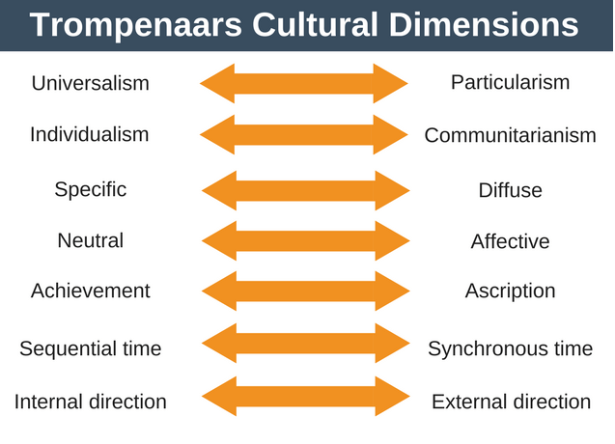

Slide 36
Universalism vs Particularism
What matter more- rules or relationships?
Universalism – the uniform application of rules and procedures regardless of situation, context or individual involved
E.g. US, UK, Germany, Switzerland, Canada, Australia
Particularism- the judging of a situation and adjusting rules and procedures according to specific situatios or specific individuals involved
E.g. Russia, China, Algeria, Jordan, Oman, countries in Latin America
Notes:
In a universalist culture- keep your promises, be consistent and explain your logic.
In a particularist culture – invest in relationship building, respect people’s needs, call out important rules. Can bend the rules for friends family
Latin America?
Includes 21 countries or territories: Mexico in North America; Guatemala, Honduras, El Salvador, Nicaragua, Costa Rica and Panama in Central America; Colombia, Venezuela, Ecuador, Peru, Bolivia, Brazil, Paraguay, Chile, Argentina and Uruguay in South America; and Cuba, Haiti, the Dominican Republic and Puerto Rico

Slide 37
Individualism vs Communitarianism
Working as a team or an individual?
Individualistic cultures- outcomes are the result of your choices
Eg Canada, US, UK, Switerland
Communitarianism- quality of life is better if we help each other
Eg Japan, China, latin America, much of Africa
Notes:
Do people want to achieve recognition for their individual achievement?
Clearly building on Hofstede
Individualistic- decision makers can make decisions without consulting others, therefore happens more quickly. Look after own happiness
Working in these cultures you should reward on an individual basis, encourage use of initiative, try and align the individuals needs with those of the organisation
Communitarianism- Organised around groups- loyalty is important. Decision making takes longer as everyone inputs. Job turnover is lower due to high group loyalty
Reward group in public and praise group in public. Praise individuals in private. Whole team should be included in decision making.
Trompenaars research yielded some interesting results and suggested that cultures may change more quickly than many people realize. It may not be surprising to see a country like the United States with high individualism, but Mexico and the former communist countries of Czechoslovakia and the Soviet Union were also found to be individualistic in Trompenaars research. In Mexico, the shift from a previously communitarian culture could be explained with its membership in NAFTA and involvement in the global economy. This contrasts with Hofstede's earlier research, which found these countries to be collectivist, and shows the dynamic and complex nature of culture. Countries with high communitarianism include Germany, China, France, Japan, and Singapore

Slide 38
Specific vs diffuse
How separate is your personal and professional life?
Specific culture- personal and work life are separate
Eg Germany, Netherlands, Austria, Switzerland, US and Australia
Diffuse culture- personal and work life are interconnected
Eg China, Japan, India, Argentina and Spain, Singapore
Notes:
Specific culture- personal and work life are separate, no overlap. Schedule focused, direct in communication and more goal oriented. Tips for working with this culture would be to have an agenda a stick to it. Set objectives for people first then build relationships.
Diffuse culture- personal and work life are interconnected. Objectives are better achieved when relationships are strong. Colleagues socialise outside of work. Courteous and respect age, status and background more.
Tips- build relationships first. Expect invitations to social occasions- you should commit to attending them. Expect to talk business in a variety of settings and personal in the workplace

Slide 39
Neutral vs affective
Do you show your emotions?
Neutral- Not so much
Affective- tend to share
Neutral- Germany, Netherlands, UK, China, Japan, Switzerland, Indonesia
Affective- France, Italy, Spain, Brazil, Oman
British ‘Stiff upper lip’
Notes:
Neutral- appear cool and rational
Tips to work with this culture- keep what you say and what your face shows in check. People in these cultures are less likely to show true emotions. Need to read between the lines. Stay on topic in meetings
Affective- share emotions in the workplace- normal
Tips- use your emotions to communicate and share how you are feeling in the workplace. Maybe learn some techniques to diffuse high emotion situations
In emotional cultures, people often smile, talk loudly when excited, and greet each other with enthusiasm. So, when people from neutral culture are doing business in an emotional culture they should be ready for a potentially animated and boisterous meeting and should try to respond warmly. As for those from an emotional culture doing business in a neutral culture, they should not be put off by a lack of emotion.

Slide 40
Achievement vs Ascription
Do you have to prove yourself to get status or is it given to you?
Achievement- earn through skills and knowledge
Eg US, UK, Scandinavian countries
Ascription- status is given to you
Eg Japan, Italy, France
Notes:
Achievement- job titles are earned and reflect knowledge and skill. Anyone can challenge a decision is they have a reasonable argument
Ascription- given status because of social status, education or age. Earn respect due to commitment to organisation- not abilities. Decisions only challenged by higher authority.
Tips for achievement culture: Praise in front of piers, avoid using titles and reward individual performance
Ascription tips- use titles. If going to challenge a decison need to handle this carefully as need to show respect to superiors

Slide 41
Sequential vs Synchronous time
One thing at a time or may things at once?
Sequential time- projects or tasks are completed in stages
E.g. US, UK, Germany, Sweden and other northern European countries
Synchronous time- lots at once
Notes:
Synchronous time- lots at once. The past present and future are interwoven. Plans are flexible, punctuality less important. Eg Japan, India and Mexico. Latin America, and Arabic cultures
Time is money.
Sequential time cultures tips- keep to deadlines, be punctual.
Synchronous time- allow time for autonomy with in schedule, allow time for latecomers. Be explicit about inflexible deadlines

Slide 42
Internal vs external direction
Do you control your environment or are you controlled by it?
Internal- people believe can control to achieve goals
E.g. US, UK, Australia
External- work with environment to achieve goals
Eg China, Russia, Saudi Arabia
Notes:
Internal- winning important in these cultures therefore aggressive personalities are prevalent.
Tips to work with people in these cultures: allow setting of own development plans, set clear goals, be open about disagreement and allow constructive disagreement
External- winning not so important as maintaining strong relationships-
Tips: use feedback not goals. Allow autonomy- the use of relationships to achieve results. Give the right resources. Balance negative and positive feedback

Slide 43
Trompenaar’s 7 cultural dimensions
No clear way to use the model
But remember to look at the person and not the country/culture
From this you can look at ways of making adjustments.

Slide 44
Time
Cultural differences are visible even from our first interaction
-late
-early
-on time?
Scheduling months in advance?
Is this possible with religious/cultural holidays?

Slide 45


Slide 46
Meeting agendas
In a linear time culture - sequential
UK, US, Scandanavia, Germany
Agenda circulated before hand, timings and subjects covered in order. No hijacking of the meeting. Taking subjects ‘off line’
In a flexible time culture- synchronic
South America, parts of Europe, Africa and middle East
Agenda likely circulated but not necessarily followed. The meeting flows in an organic way, sub groups of discussion may form.

Slide 47
The importance of understanding cultural impacts on business
Multinational and global companies need to consider the impact of culture as cultural norms influence a wide range of work preferences:
Perceptions of authority
Leadership style
Fairness
Distribution of rewards/punishment
Interpersonal relationships
Communications
Expectations of the organisation

Slide 48
Cross-cultural Relationship Building
Building relationships is in the top priority, and law comes last -Highly collective (Hofstede), embeddedness value (Schwartz)
Real power is concentrated at the top; not easy to meet and talk with higher ranking people -High power distance society (Hofstede)
Committed to relationships rather than to schedules -Polychronic time orientation

Slide 49
Exercise
Given country scores on Hofstede’s cultural dimensions, what do you think would be the problems encountered by a company from country list A in networking and building relationship with clients from the country list B (even at the risk of some stereotyping and sweeping generalisation)?
Country list A –company Country list B -client
American Japanese
Japanese French
French Swedish
Swedish Japanese

Slide 50
BREAK
Please read Navigating the Cultural Minefield by Erin Meyer https://elevate.talis.com/glos/player/modules/66fc16b25156ddd73dcc0fa2/resources/6702998f2ce7860715744a38?page=0

Slide 51

The culture Map by Erin Meyer
8 Dimensions
Communicating
Evaluating
Persuading
Leading
Deciding
Trusting
Disagreeing
Scheduling

Slide 52
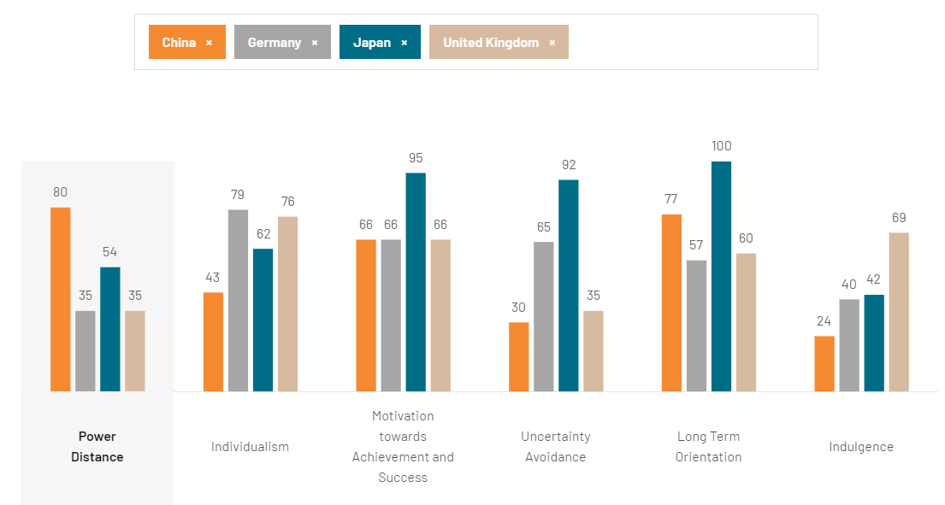
https://www.theculturefactor.com/country-comparison-tool?countries=china%2Cgermany%2Cjapan%2Cunited+kingdom

Slide 53
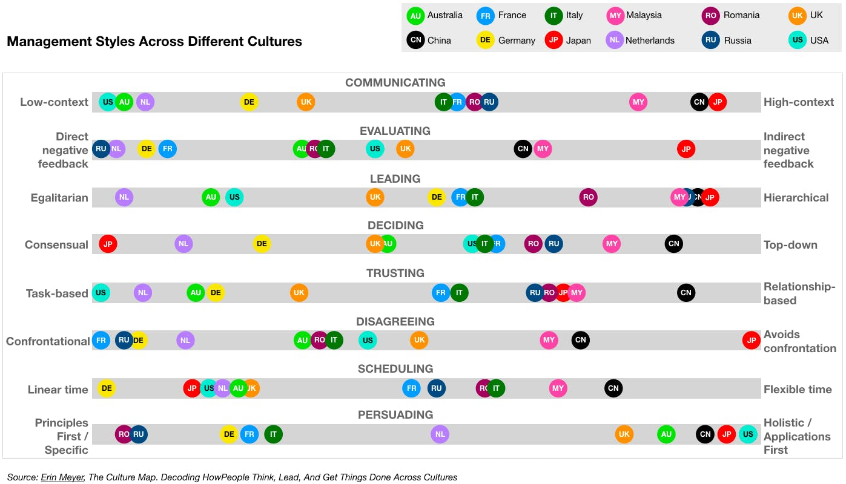

Slide 54
Individual activity
Using your new knowledge of cultural dimensions and country cultures consider 3 country cultures that you would like to put forward for the assessment.
Be prepared to justify your selections to your group in the next activity.
https://www.theculturefactor.com/

Slide 55
Activity
In groups
Discuss your individual suggestions for the country cultures we should use for the assessment.
Consider the different cultural dimension we have covered today as well as the dynamic that can be formed between cultures.
As a group select 3 cultures to submit to the class. Please makes sure that these country cultures can be found on https://www.theculturefactor.com/

Slide 56
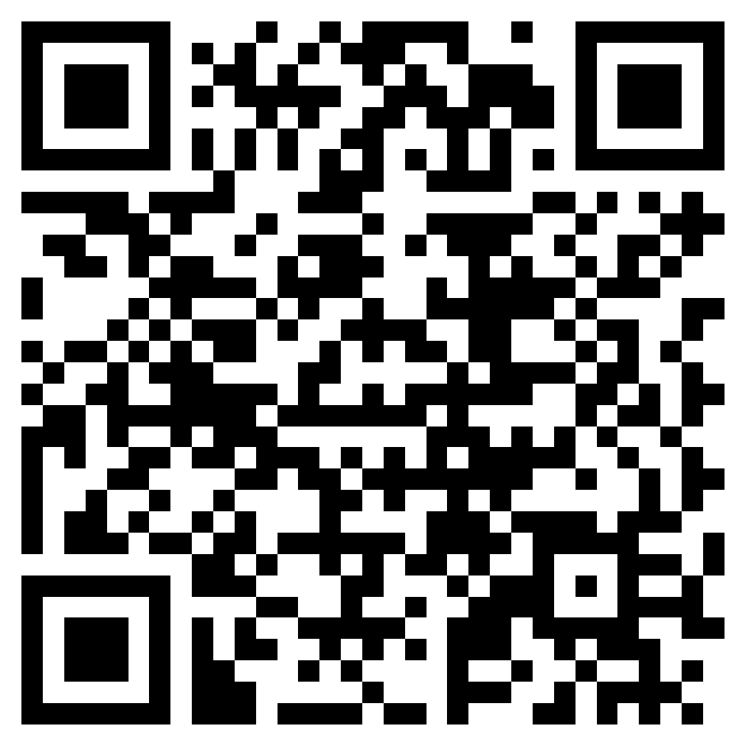
As a group Submit your 3 country culture choices here
https://forms.office.com/e/kG4UrVGS5Q?origin=lprLink

Slide 57
Outcomes of today’s session
Today we have learnt about some different theories of cultural values and looked at how these can affect our behaviour. We have covered:
-Hofstede
-Schwartz
-Trompenaar
-Meyer
These link to your learning outcomes for this module and will underpin your understanding and critical evaluation needed for your assessment.

Slide 58
Group discussion
How do you build relationships in your culture?
What do you do to build, maintain and secure the relationship?
Your experience in building relationship with people from other culture.

Slide 59
Cross-cultural Relationship Building-with employees from different cultures
British manager A has been working in host country for few years and has built good relationships with local counterparts in the joint venture company
“It is very clear to me that they put family interests in a very high position on the list of personal frameworks for making decisions. The company for them is in a much lower order of importance. People make decisions based on this issue and I need to adapt my thinking and mind-set for it … One senior local manager asked me once personally if I could provide a job for his nephew.”
What are the cultural issues illustrated here? Which Hofstede’s culture dimension can be used to explain the cultural differences in this case?

Slide 60
Relationship Building in Highly Collective Societies
Clearly distinguish between members of in-group and those of the out-group; individuals expect their groups to care for them in exchange for unquestioning loyalty
People act in the interests of the group; prioritise in-group goals, and connected relationships
In-group considerations affect hiring and promotions with closer in-groups (such as family) and get preferential treatment
Employee commitment to the organization is low, but not necessarily to the people in the organization.
Recruitment and promotion opportunities tend to be more dependent on seniority, ethnicity, gender, religion, or birth -Ascription(Trompenaars)
What does this mean to anyone from low collective / individualistic society?

Slide 61
Cross-cultural Relationship Building-with business partners /clients / government
Local manager A who works for British MNC
“If you want someone to sit down and listen to you talk about your business, you have to invest something on building the relationship before you can do it … The most important issue is whether it is good for the business. It is a matter of cost-benefit. I often tell my boss if I spend 1000 RMB [£77] to buy a gift and give it to one government official, it is for relationship building. Because he can approve me or our company’s operation, we can get things done 3 months earlier. Of course, I don’t have to do that. You can just wait for 3 months, then you lose 3 months business opportunities.”
What are issues are illustrated here?

Slide 62
Cross-cultural Relationship Building-with business partners /clients / government
British expatriate manager:
“Here, people work within particular influence groups, peer groups and different classes of people work together, and they are all connected in some way. We [Westerners] don’t really often understand all the connections. That’s something that is a lot more difficult to comprehend in this role. …. I think it has been said to me on many occasions that it would be completely thoughtless of me not to send gifts to the key stakeholders as part of a way of recognising them and their importance.”
What are issues illustrated here?

